Slide 1
FINAL YEAR PROJECT (E-Commerce Website)
Name: Ong Chee Soon
WAWASAN OPEN UNIVERSITY
Date:30-04-2020

Slide 2
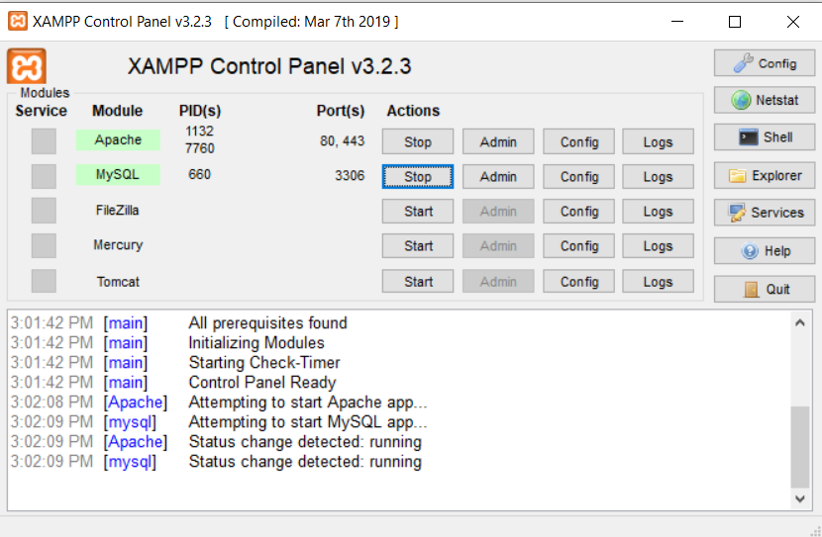
OPEN THE XAMPP Control Panel
Make sure the Apache and MySQL have clicked the Start button.

Slide 3
Open the browser
This project has included two url:
1. localhost/misaimanmalaysia (For all the customers can view and purchase the product this website)
2. localhost/misaimanmalaysia/admin.php (Only for the administrator can view and edit in this website)

Slide 4
Introduction for E-commerce Website
I will explain what the function I have created in the webpage.

Slide 5
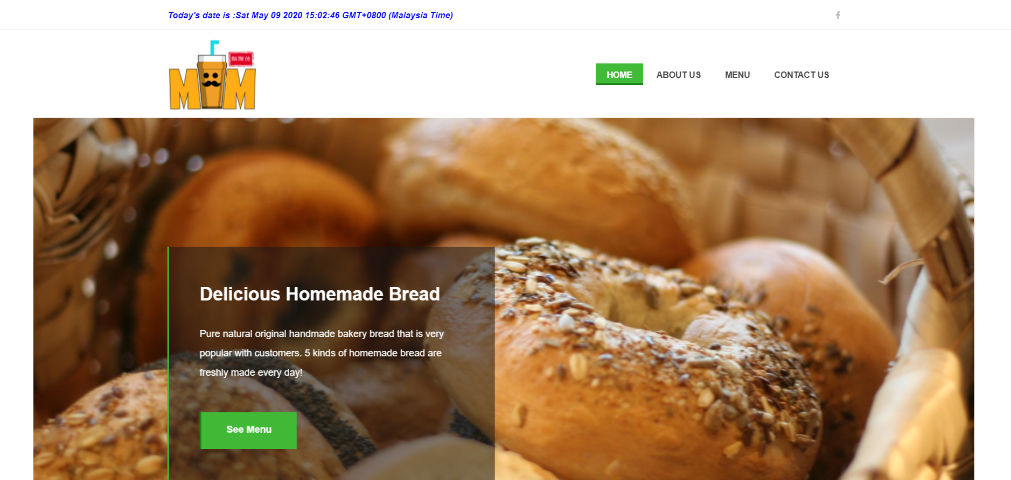
Home Page

Slide 6
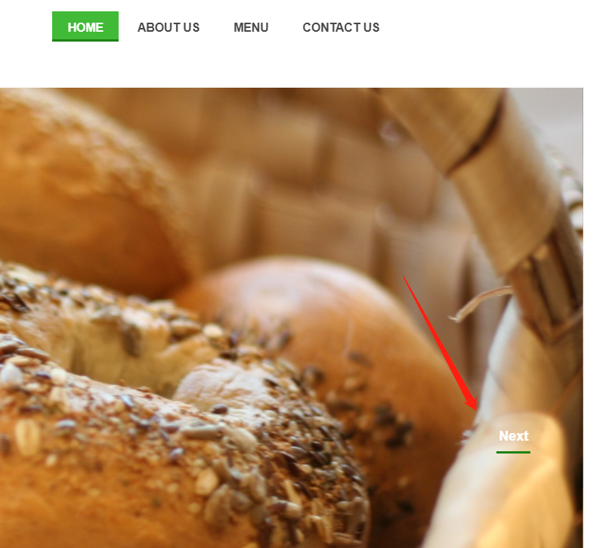
Home Page function
1. I have add the current date and time to let the customer easy to know the current date and time.
2. Can switch the slide in the dashboard.

Slide 7
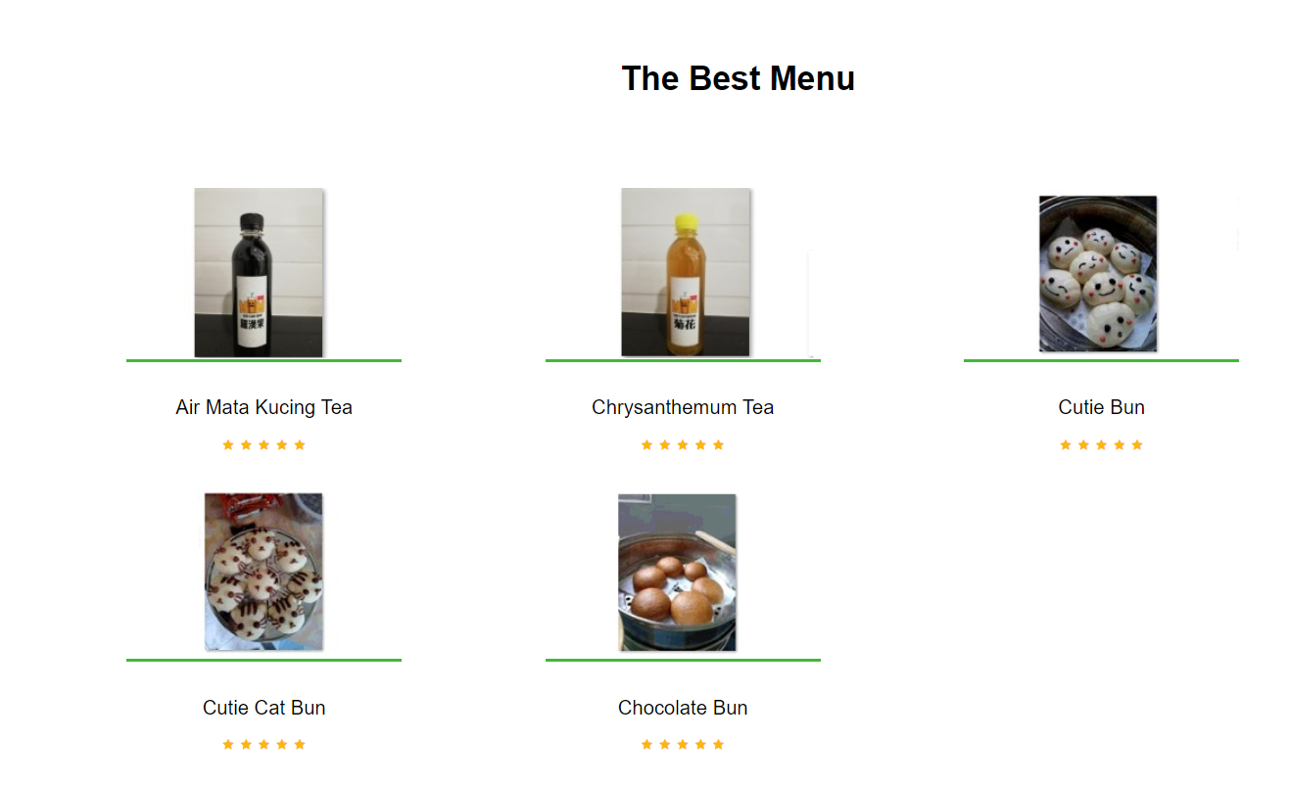
Home Page Function
In the below Home Page will show the menu picture and ranking.

Slide 8
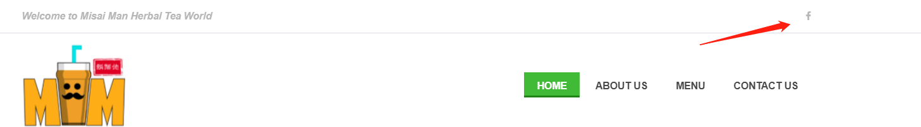
Home Page Function
At the top of the Home page, it will show the “f” icon. This icon is let the customers to click the link to access Misai Man company social media Facebook.

Slide 9
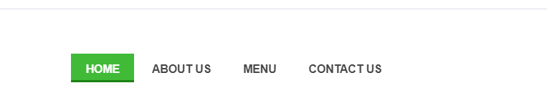
Home Page Function
At the top of Home Page, it shows the 4 tabs to let the customer to choose the content in the page.

Slide 10
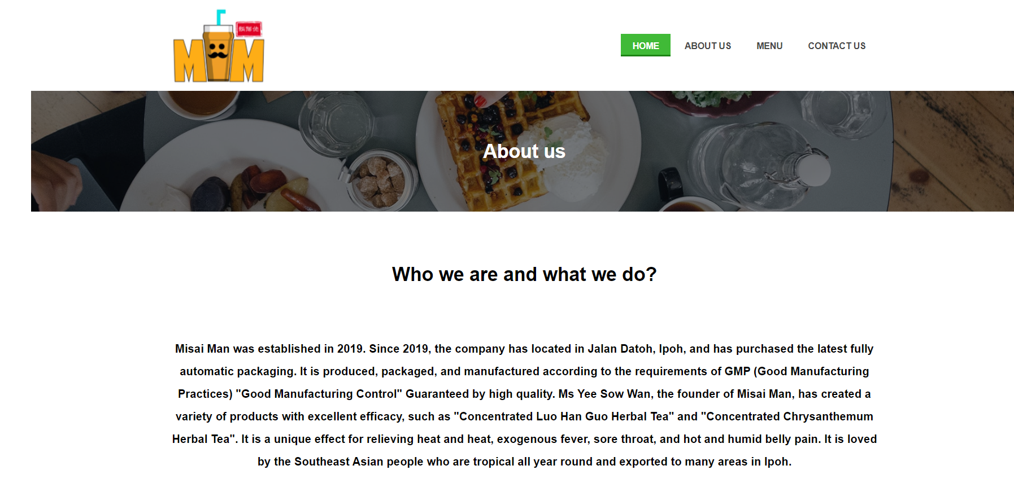
About Us Page
In the About Us page, this page will introduce the Misai Man company the background details.

Slide 11
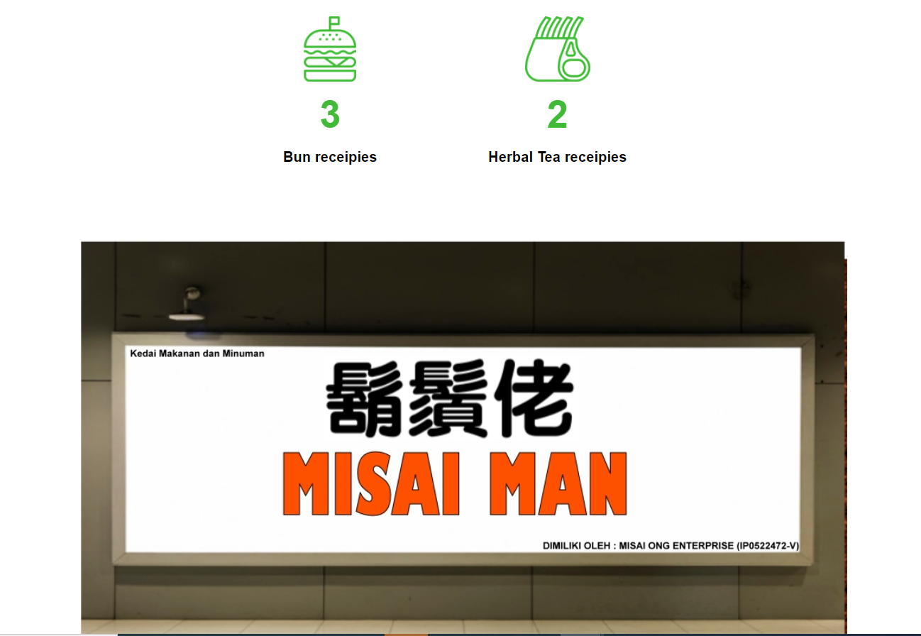
About Us Page
In the below the about us page, two logos will count how many products for the Misai Man company. For example, the bun receipies have three types and the herbal tea receipies have 2 types.

Slide 12
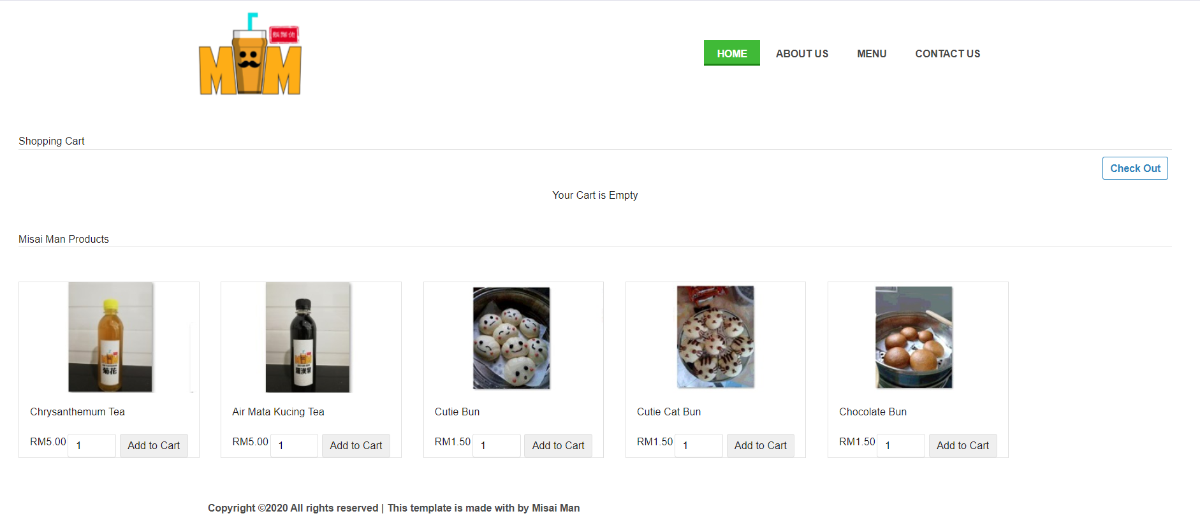
Menu Page
In the menu page, all the product will show in this page. It will show the product name, price and the amount.

Slide 13
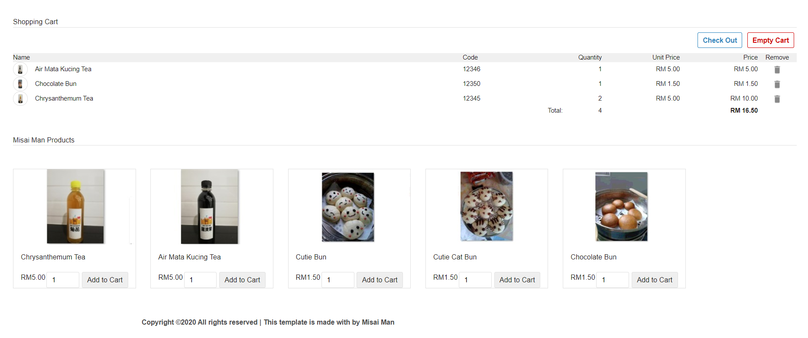
Menu Page Function
After the customer to choose the amount of the product, the list of choose the products will show in the above shopping cart. In the shopping cart, the customer can remove and add the products again. It also will show the total quantity and the price in the shopping cart.

Slide 14
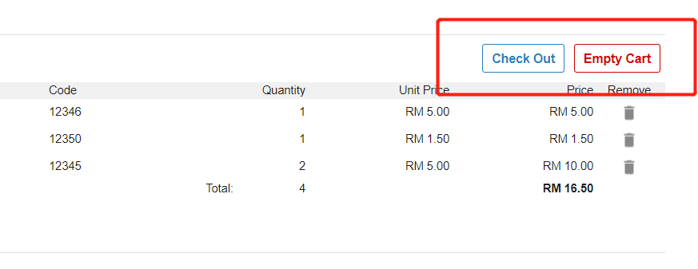
Menu Page Function
The empty cart button can let the customer direct to clear all the selected the products. The checkout button is turned to the next page after finish to select the items.

Slide 15
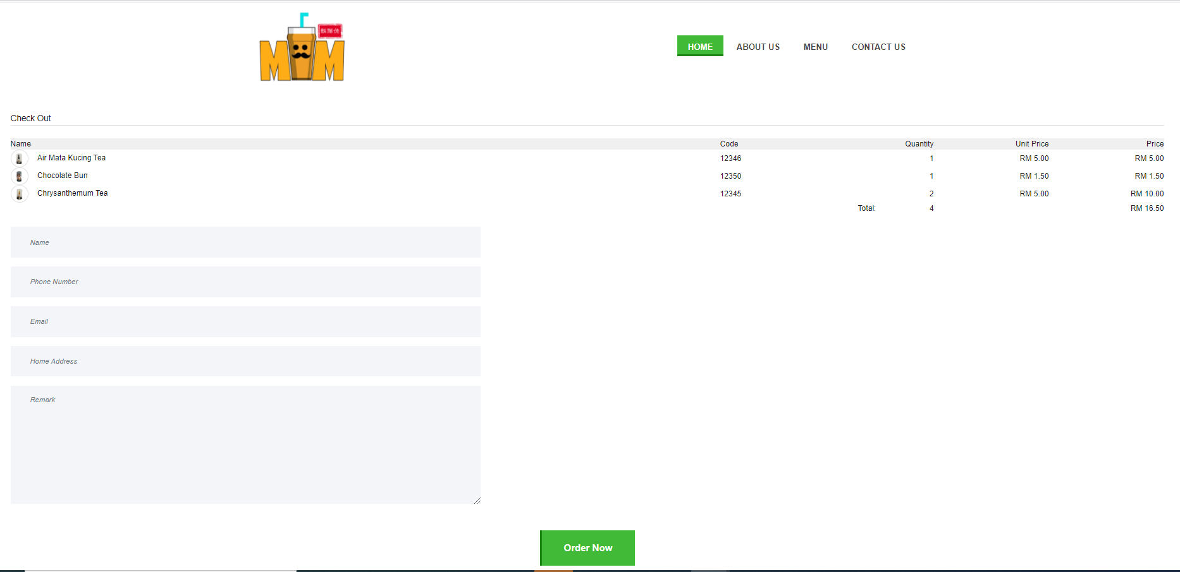
Menu Page (Checkout Function)
After customers clicked the checkout button, they will bring the customer to the checkout page. The customers can double-check their purchase the details of the product in the checkout page, and insert their details then click the “Order Now” to submit to the admin.

Slide 16
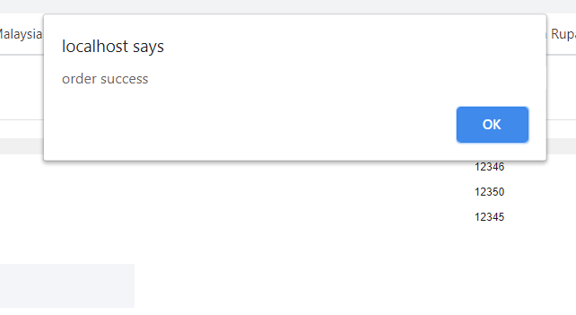
Menu Page (Checkout Function)
After clicking the “Order Now” button, the system will show the message “order success” for the customers.

Slide 17
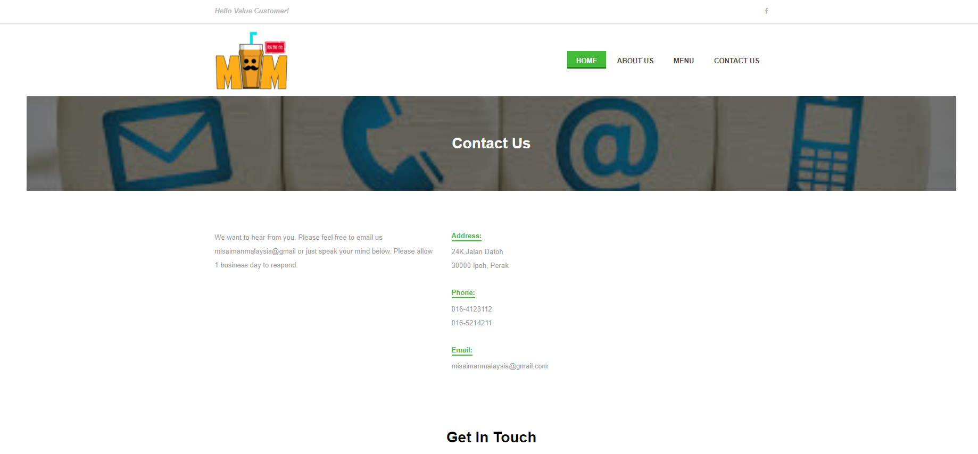
Contact Us Page Function
In the contact us page, this page will show the company address, phone and the email for the customer view.

Slide 18
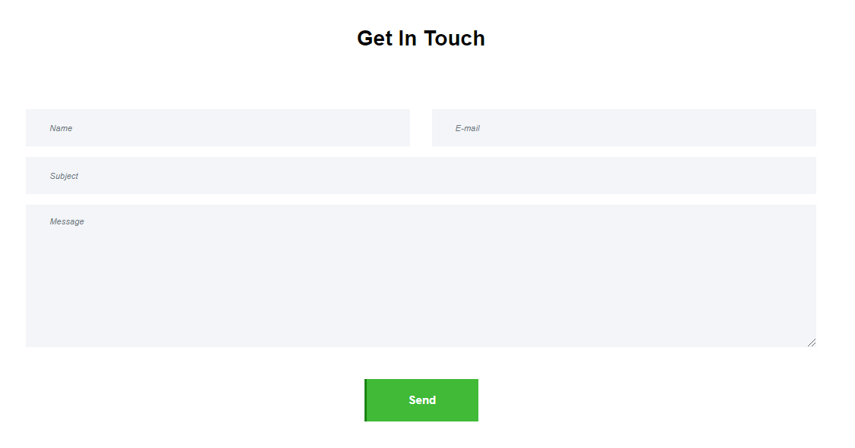
Contact Us Page Function
In the below the contact us page, it can get in touch with the customer. Customer can fill in the feedback, after click the “Send” button, the message will send to the administrator to check.

Slide 19
Admin Page
In the admin page, the administrator need to insert URL is localhost/misaimanmalaysia/admin.php to access the admin page. The admin page can check the purchase record and the feedback from the customer.

Slide 20
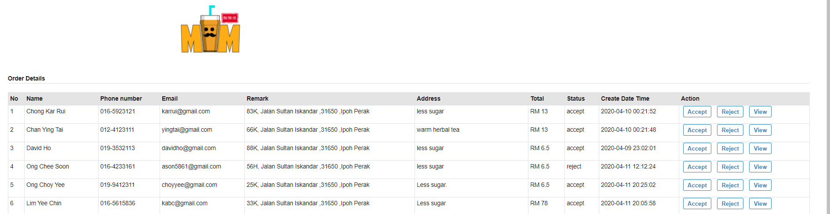
Admin Page Function
In the admin page, the administrator at the top page can view the order details from the customers. The administrator can click the accept, reject and view the action in the order details table.

Slide 21
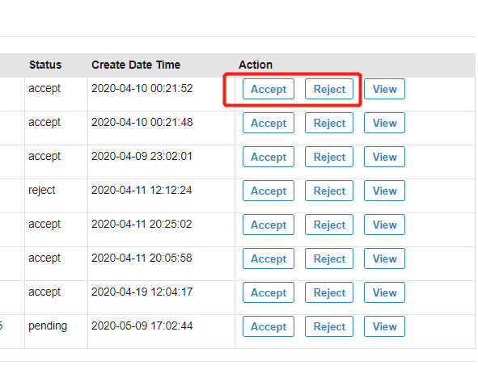
Admin Page Function
The administrator clicks the accept button, the status will change the “accept” word, if the administrator clicks the “reject” button the status will change show the “reject” message.

Slide 22
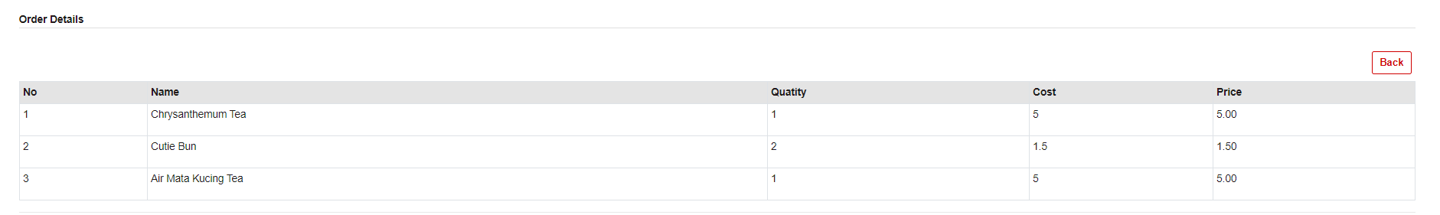
Admin Page Function
The administrator click the view button, the administrator can view the this customer order details. After view the details, can click the “Back” button to back the preview page.

Slide 23
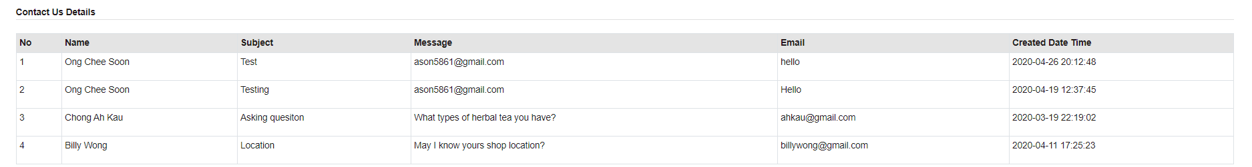
Admin Page Function
In the below the admin page, all the contact us details will show in the table.
Note: Misai Man company will later upgrade the existing website system. The current practice is that they will require double verification with customers before delivery to collect payment or electronic payment after payment.

Slide 24
Youtube Demo Project URL
https://youtu.be/qqqh3pysHOo
All source codes and the install guideline in this link https://github.com/ason5861/5PSEP1Z__051150012_FYP .

Slide 25
THE END

